Slide 1
SQL Server R Services ABQSQL, January 8, 2016

Slide 2
About Me
Chris Hyde
Owner and Principal Consultant for Hydrate Consulting
MCSA – SQL Server 2008, MCITP
15+ Years experience with SQL Server
Contact Me:
Email: chris@hydrate.consulting, chrishyde325@gmail.com
Twitter: @ChrisHyde325

Slide 3
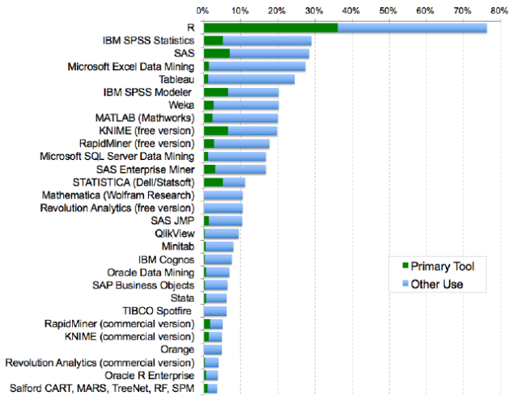
R
Source: TBD

Slide 4
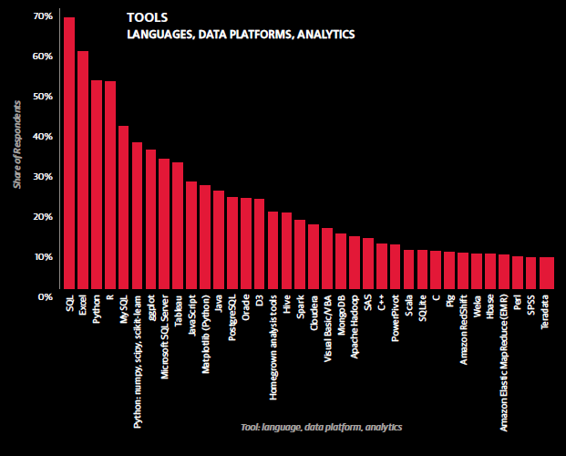
R
Source: TBD

Slide 5
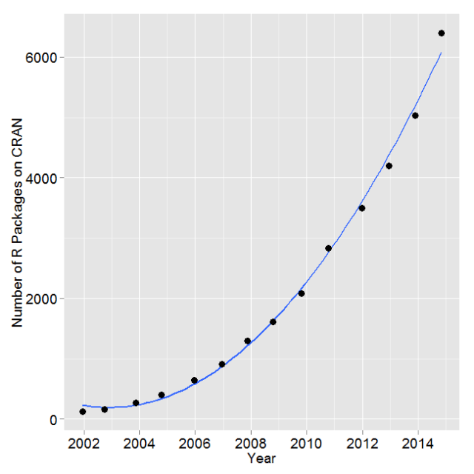
R
Source: TBD

Slide 6
Installing SQL Server R Services, part 1
1. Install Advanced Analytics Extensions
https://msdn.microsoft.com/en-US/library/mt590808.aspx

Slide 7
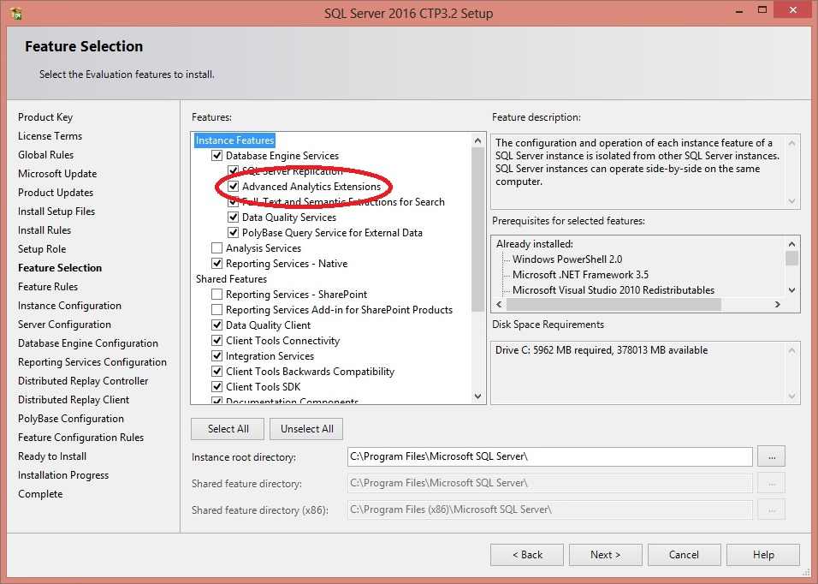
Installing SQL Server R Services, part 2

Slide 8
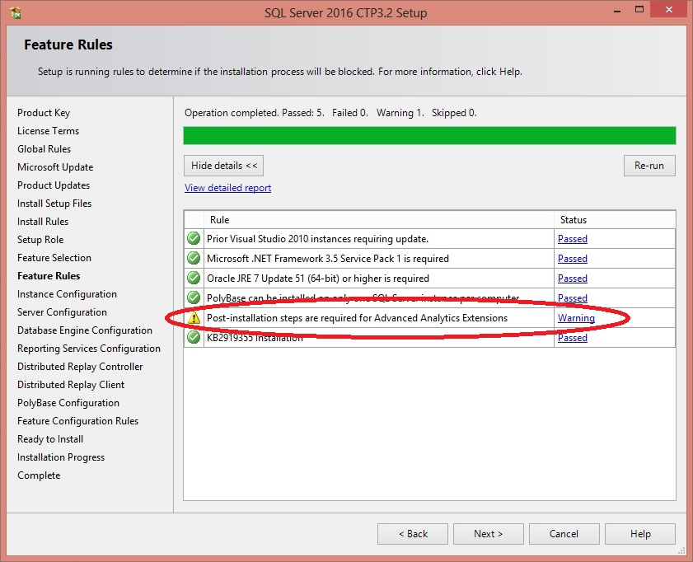
Installing SQL Server R Services, part 3

Slide 9
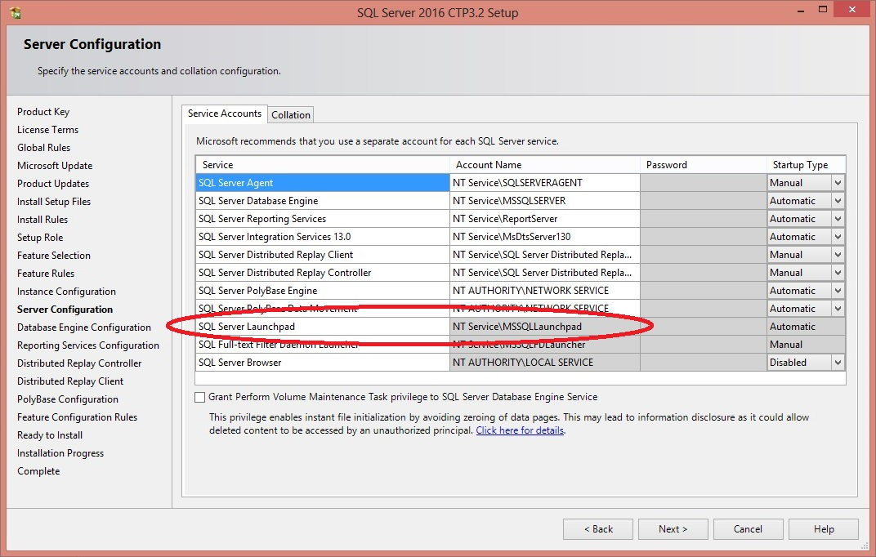
Installing SQL Server R Services, part 4

Slide 10
Installing SQL Server R Services, part 5
2. Install Revolution R Open 3.2.2 on database server
(R runtime engine)
3. Install Revolution R Enterprise 7.5 on database server
(R platform)
https://msdn.microsoft.com/en-US/library/mt590809.aspx

Slide 11
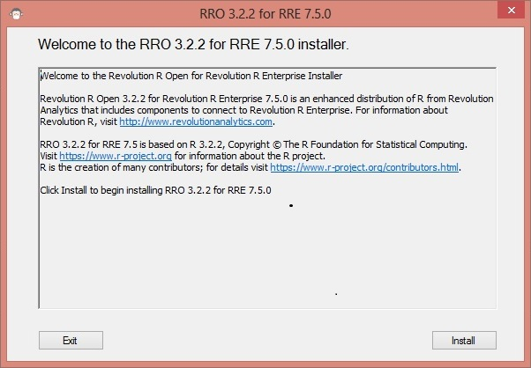
Installing SQL Server R Services, part 6

Slide 12
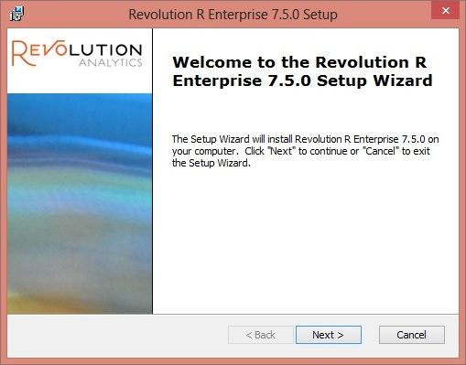
Installing SQL Server R Services, part 7

Slide 13
Installing SQL Server R Services, part 8
Post-installation scripts and configuration
1. Enable external scripts
EXEC sp_configure 'external scripts enabled', 1;
RECONFIGURE;
2. Configure memory appropriately
3. Post-installation command script
https://msdn.microsoft.com/en-US/library/mt590536.aspx

Slide 14
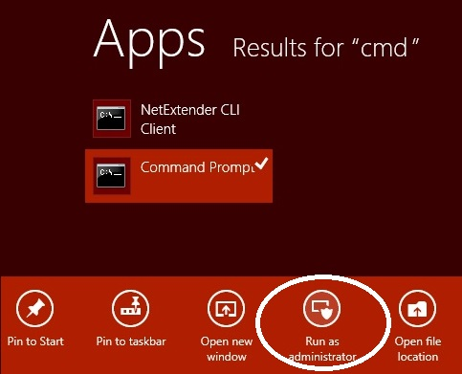
Installing SQL Server R Services, part 9

Slide 15
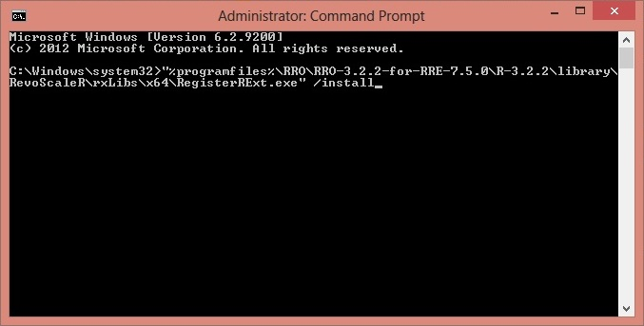
Installing SQL Server R Services, part 10

Slide 16
Getting Data Into and Out Of R
DEMO

Slide 17
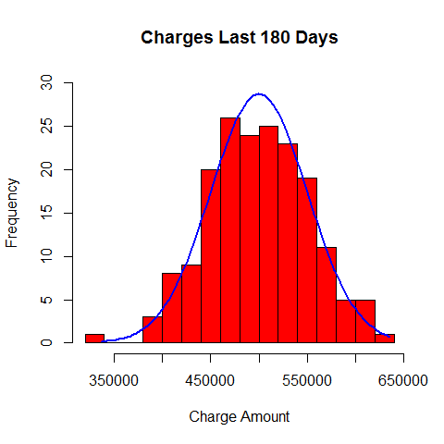
Distribution of Charges

Slide 18
Distribution of Charges
DEMO

Slide 19
Overbooking
DEMO

